Slide 1
Food and Snack Offerings
Halloween 2024

Slide 2


Bendon Overview
Since its founding in 2001 in Ashland, Ohio, Bendon has become the industry leader in licensed children’s activities. From coloring books and storybooks to toys and games, our thoughtfully designed product line spans a variety of creative play patterns with engaging content and hands-on activities that encourage imagination and fun. For 20 years, Bendon has been dedicated to delivering what retailers and consumers value most—high-quality, affordable products featuring beloved characters, EDLC and EDLP, strong margins, on-time deliveries, and quick speed to market.
About Bendon
Bendon at “X”
(insert a little blurb about the history of Bendon and your specific retailer – feel free to include images or renderings of your set if you have them)
In over 85,000 retail stores
Over 50 license partners, representing over 230 brands
Business model to succeed
Socially aware and responsible
Our lean business model allows flexibility and quick speed to market on strong value propositions.
Bendon produces many coloring and activity products in the USA and is a founding member of Disney’s License to Lead green initiative.
Positioned to be
a strategic partner
Built to last and
poised to grow
Relationships with the world’s largest entertainment studios and access to POS for over 85,000 retail outlets enable us to predict trends and react quickly.
Bendon is founder-led with an experienced executive team, profitable from inception, and has continued growth with acquisitions.

Slide 3
Company History

Slide 4
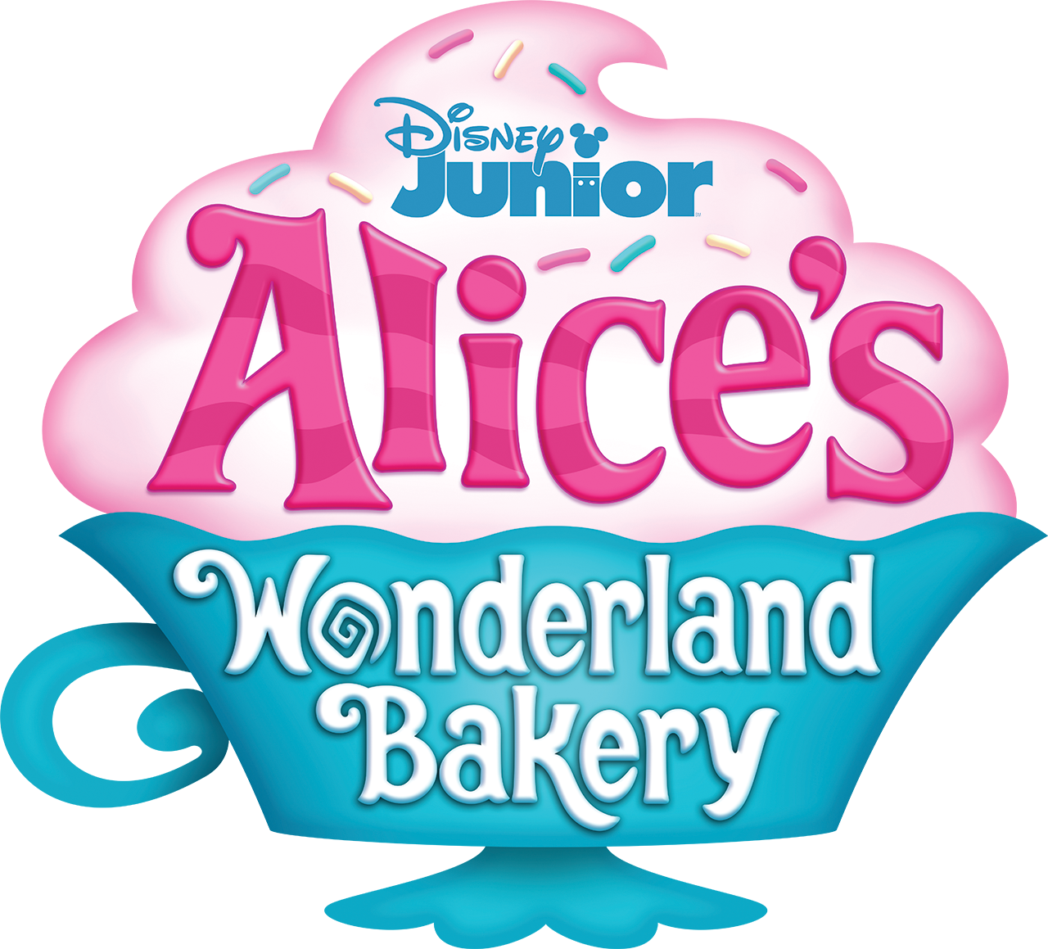





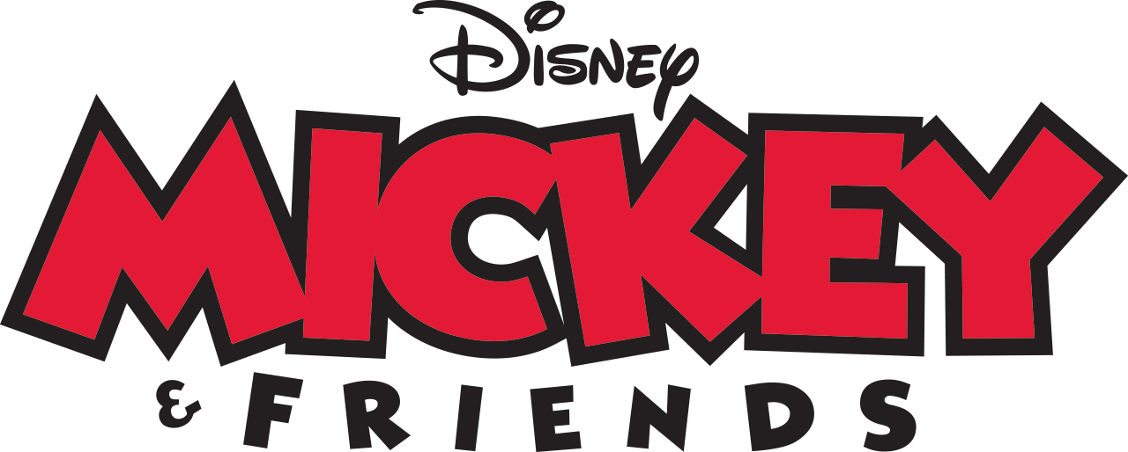

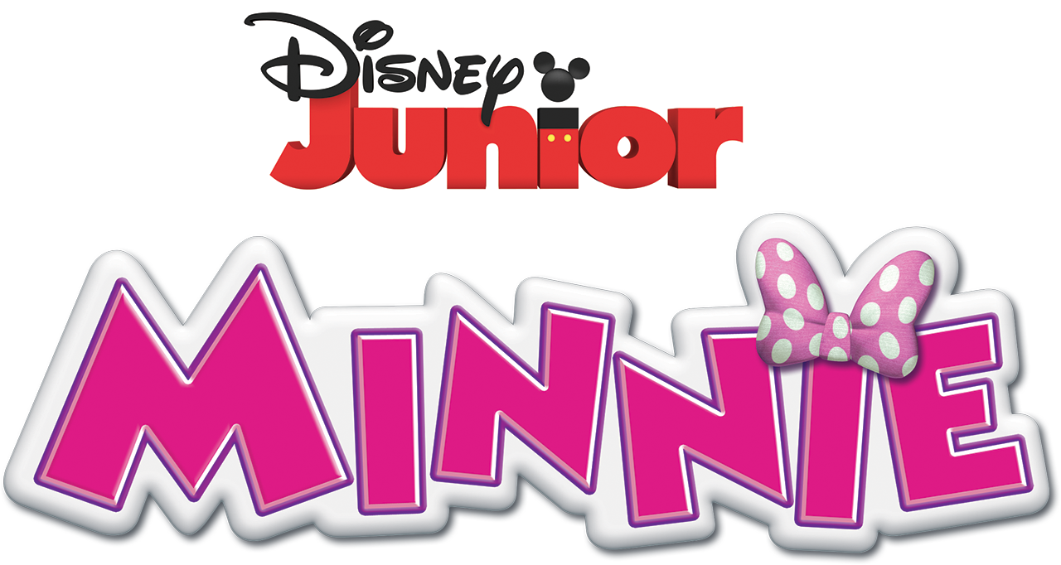
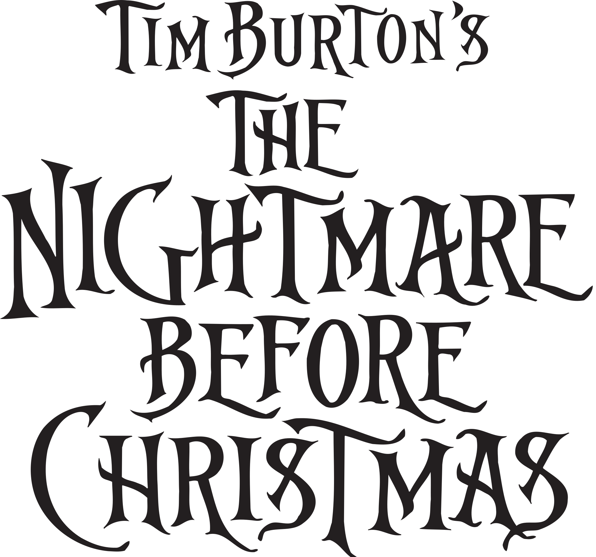

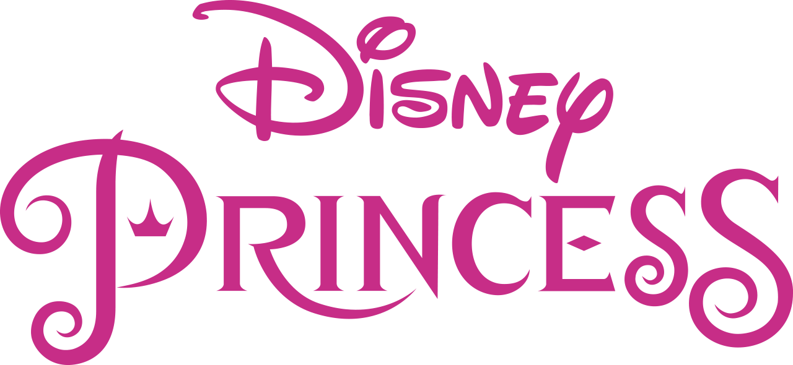
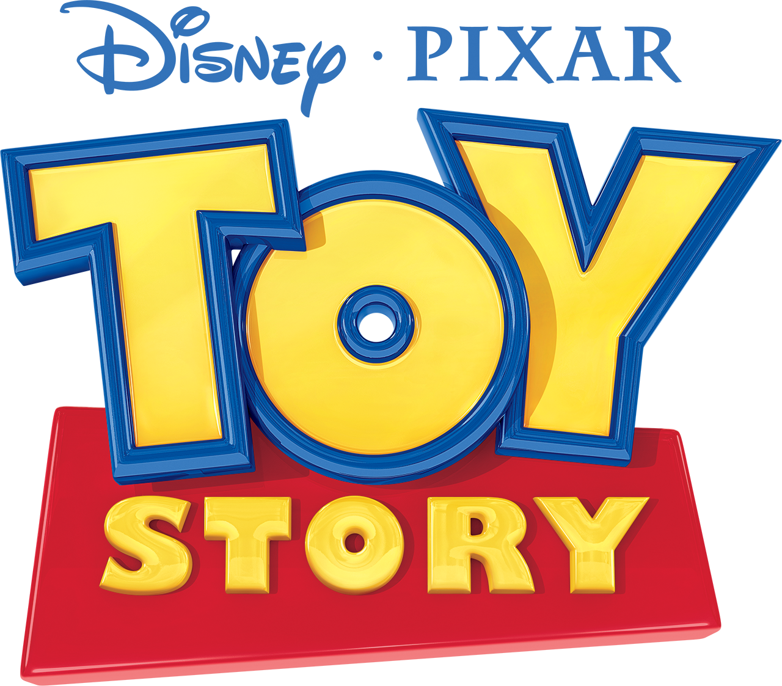

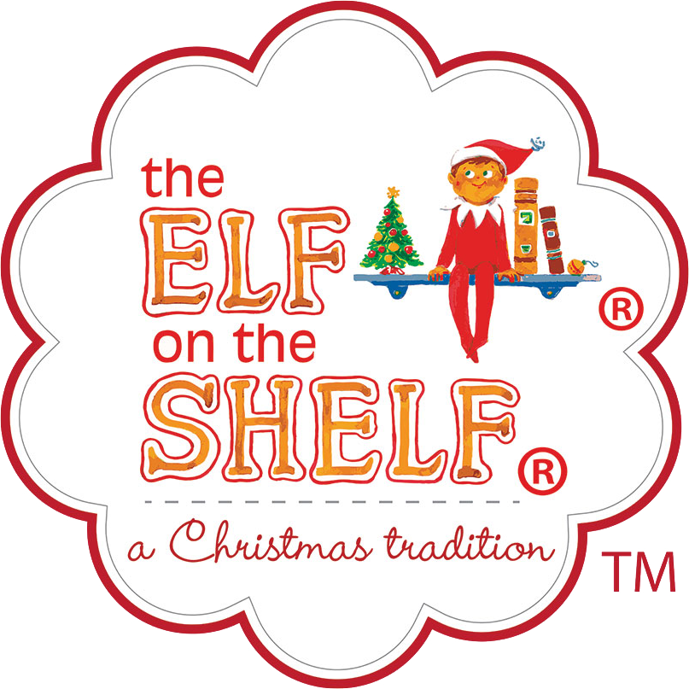
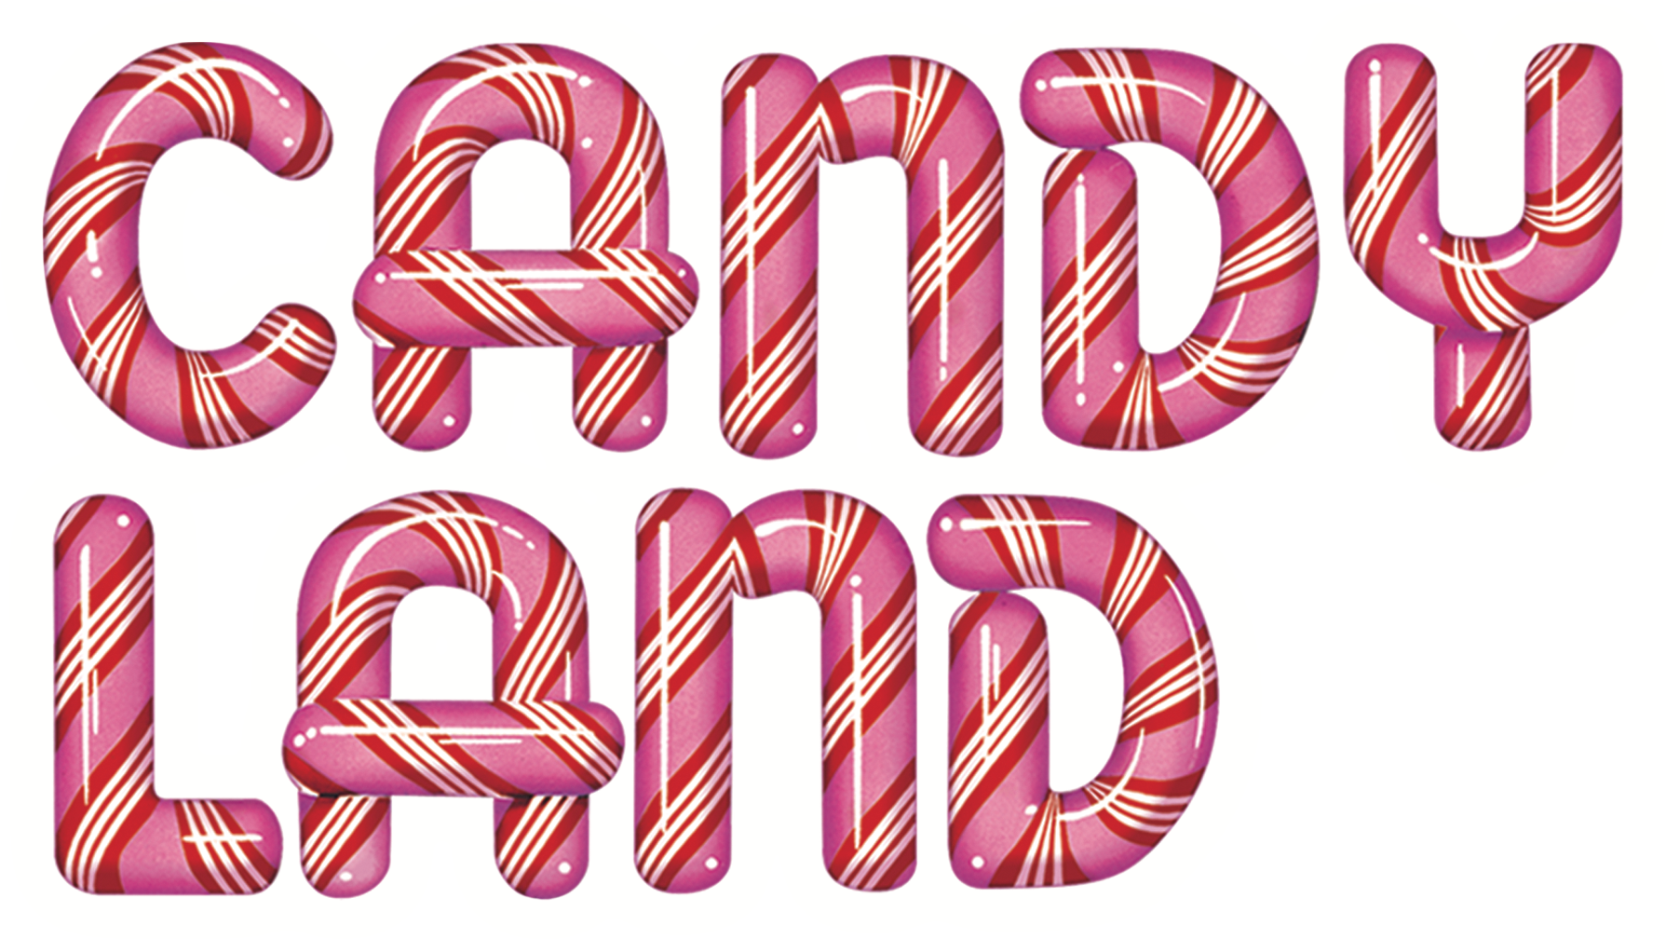


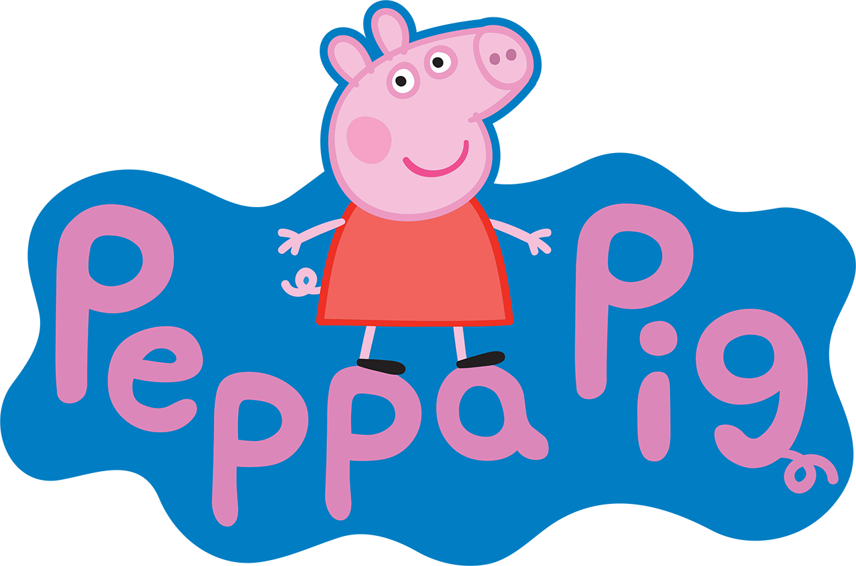

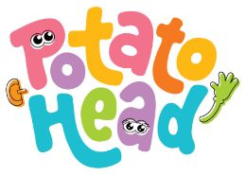



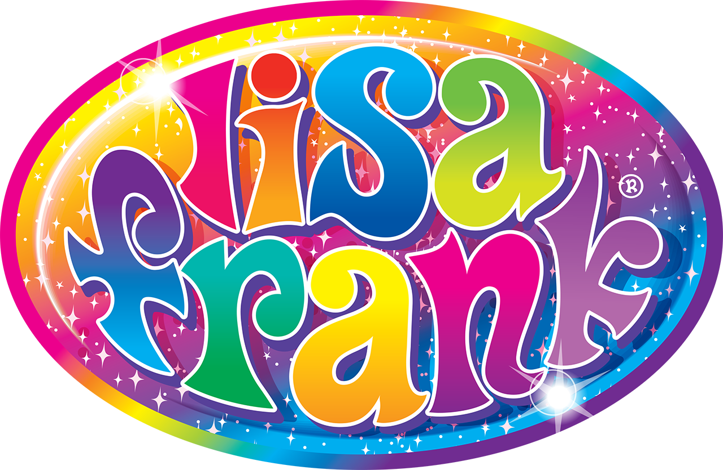


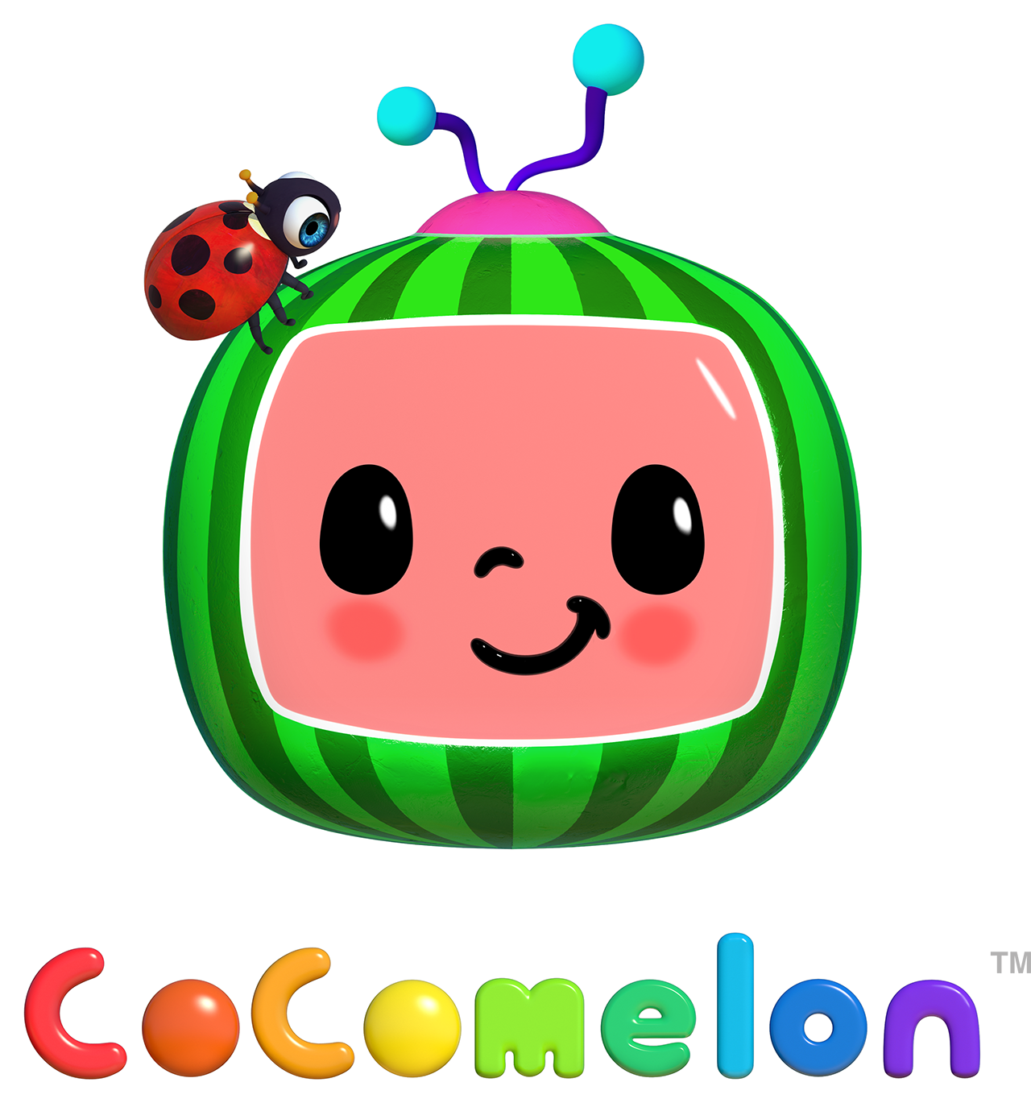



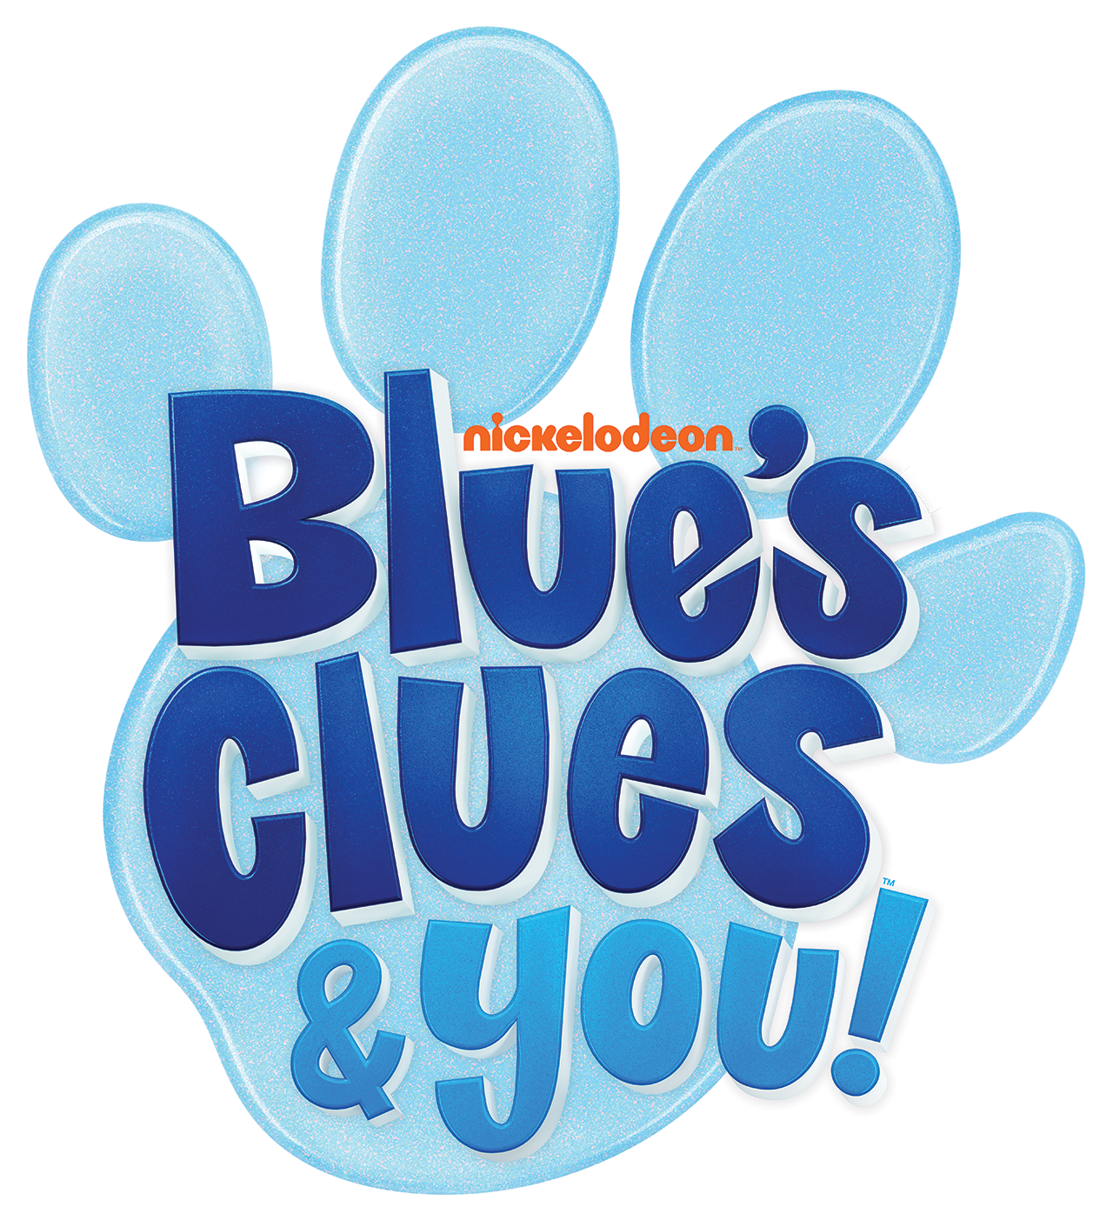

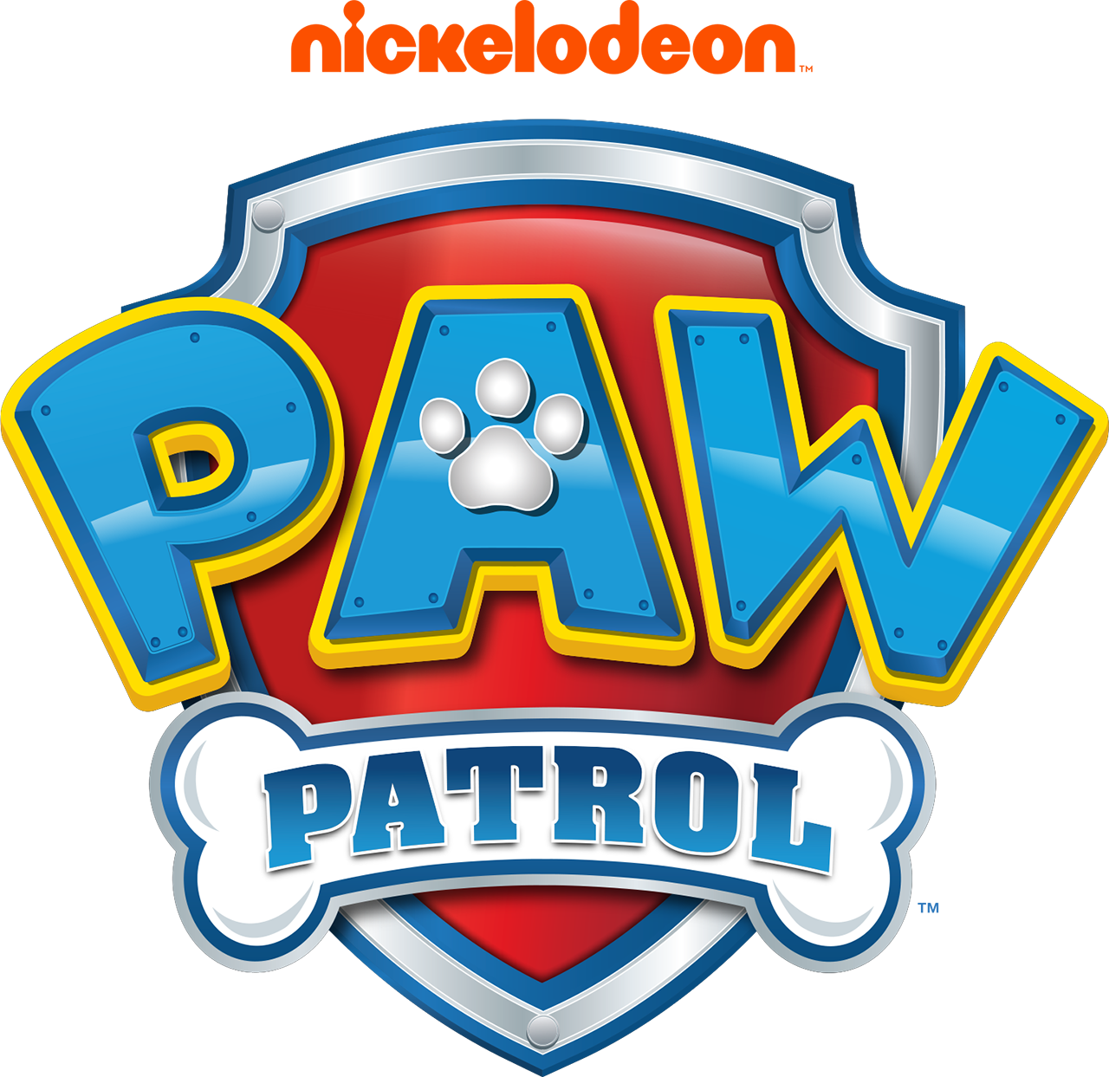


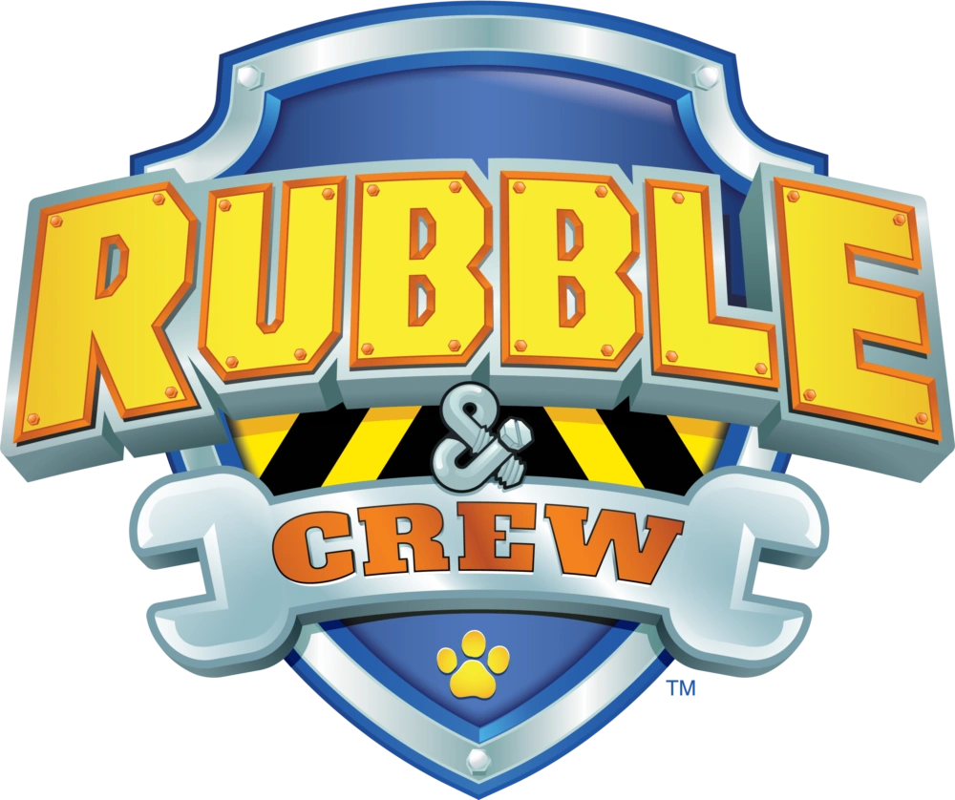


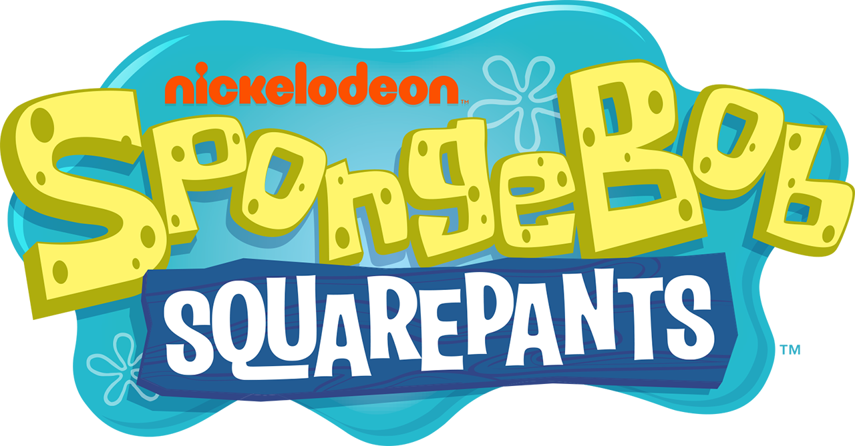

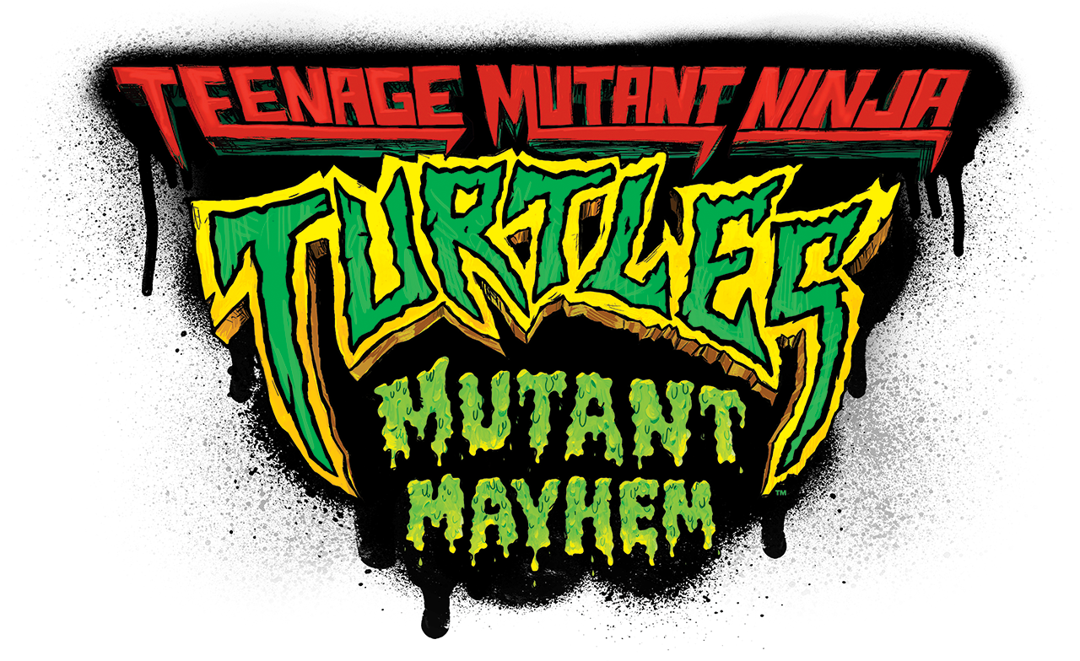
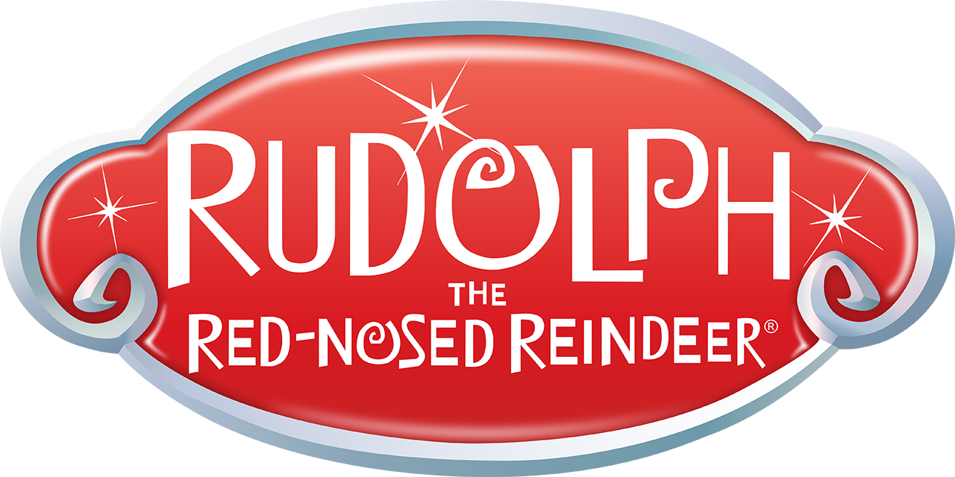
Bendon Food License Portfolio

Slide 5
Candy

Slide 6
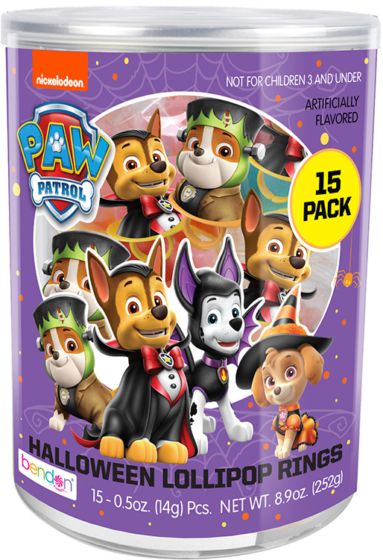
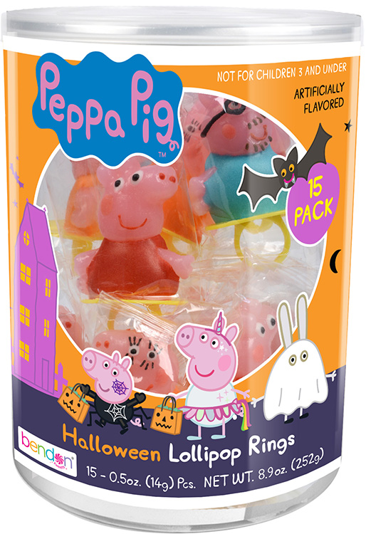
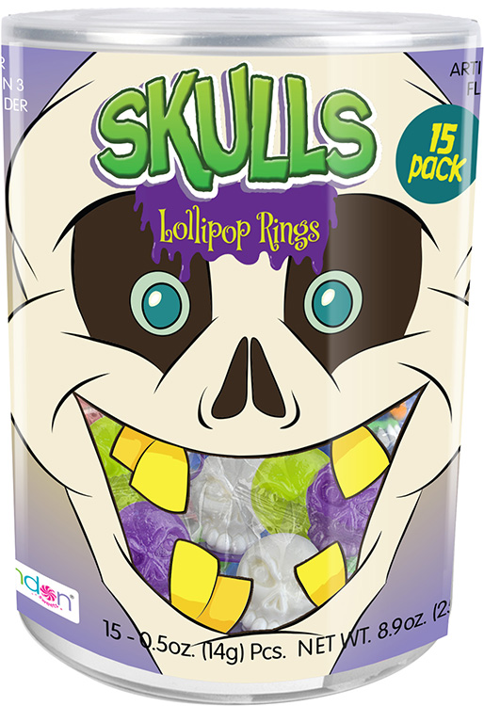
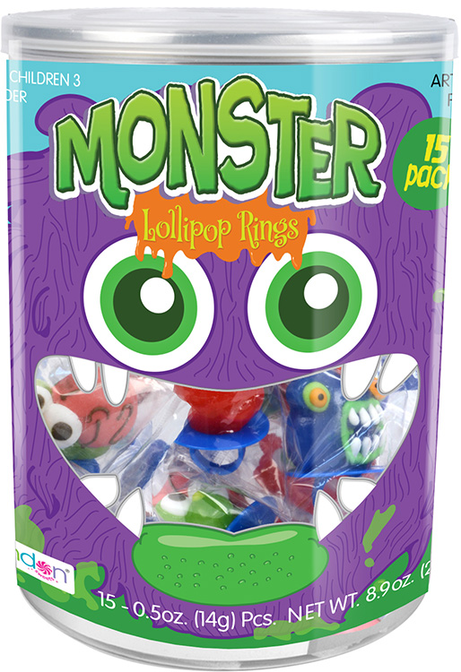
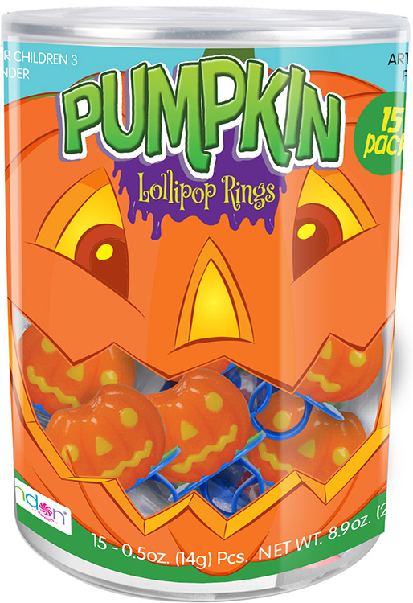
15-pack Character Shaped Lollipop Rings
15-pack 0.5oz Lollipop rings
Case Pack – 6
SRP: $8.99
Made in a Nut Free facility
HC0003

Slide 7
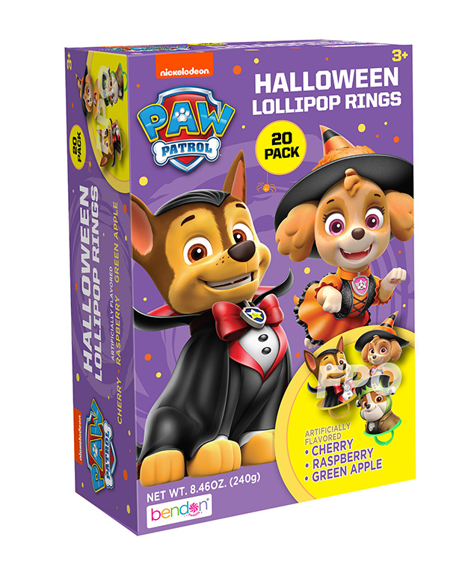
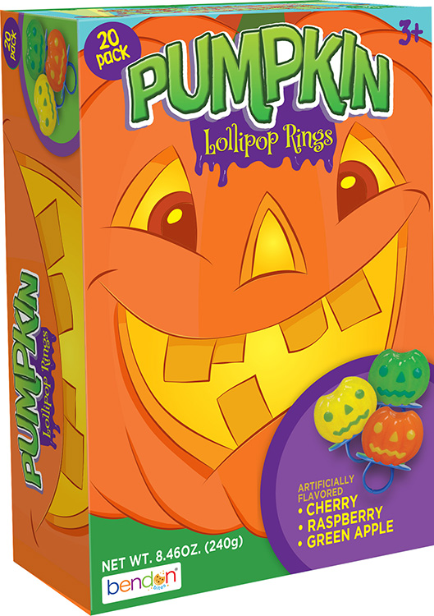
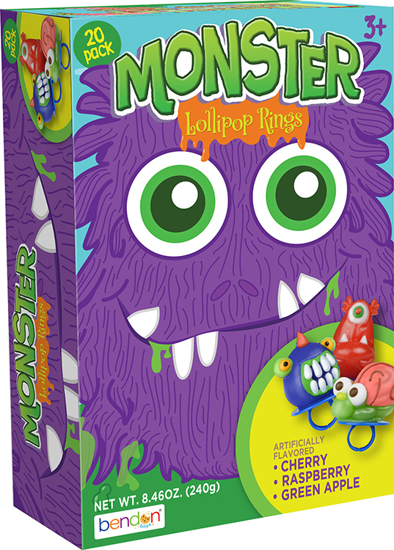
20-pack Character Shaped Lollipop Rings
20-pack 0.5oz Lollipop rings
Case Pack – 6
SRP: $9.99
Made in a Nut Free facility
Other titles available:
Bendon Skulls
Peppa Pig
HC0010

Slide 8
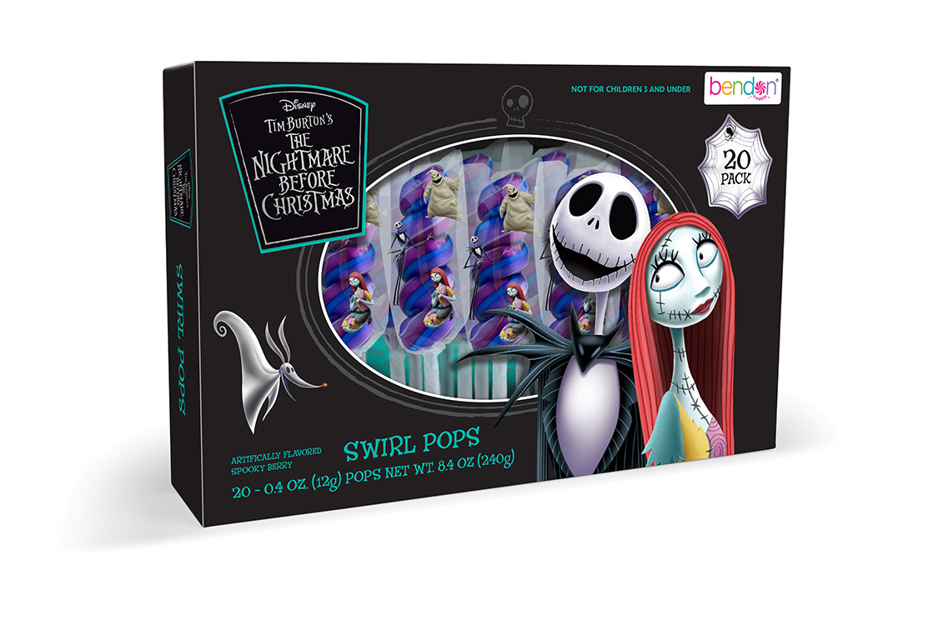
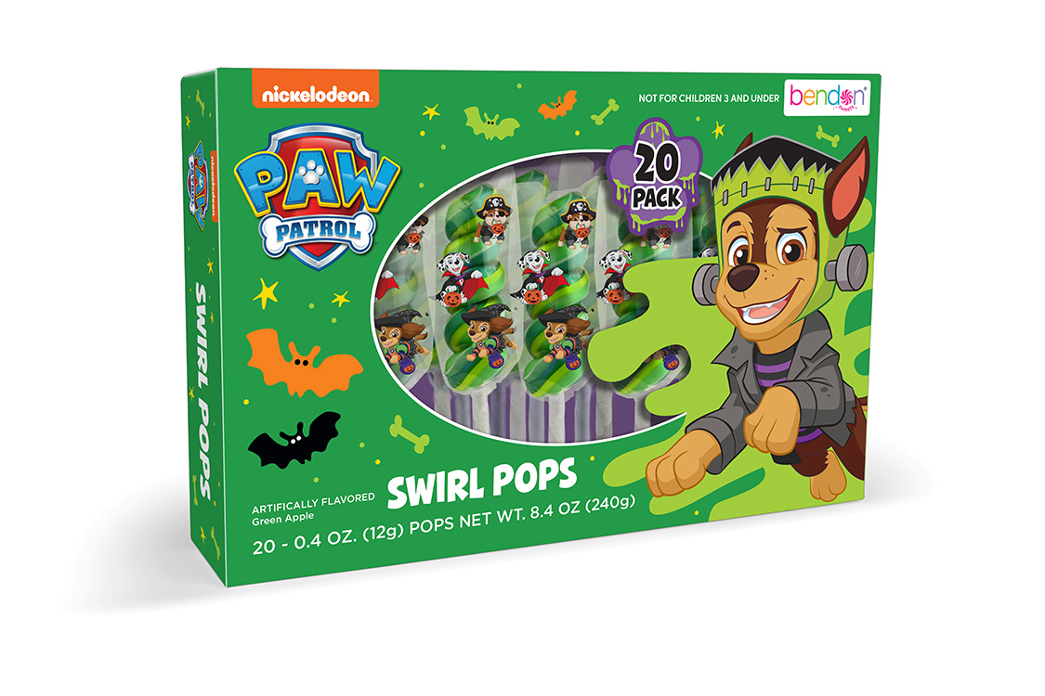
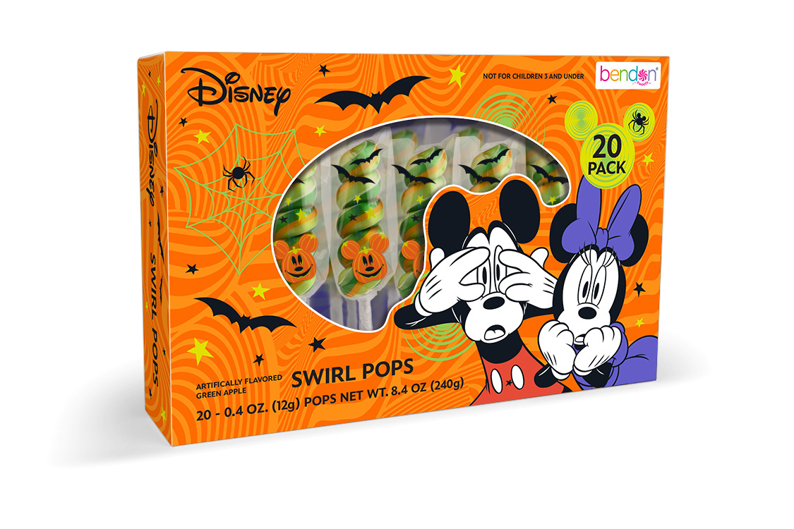
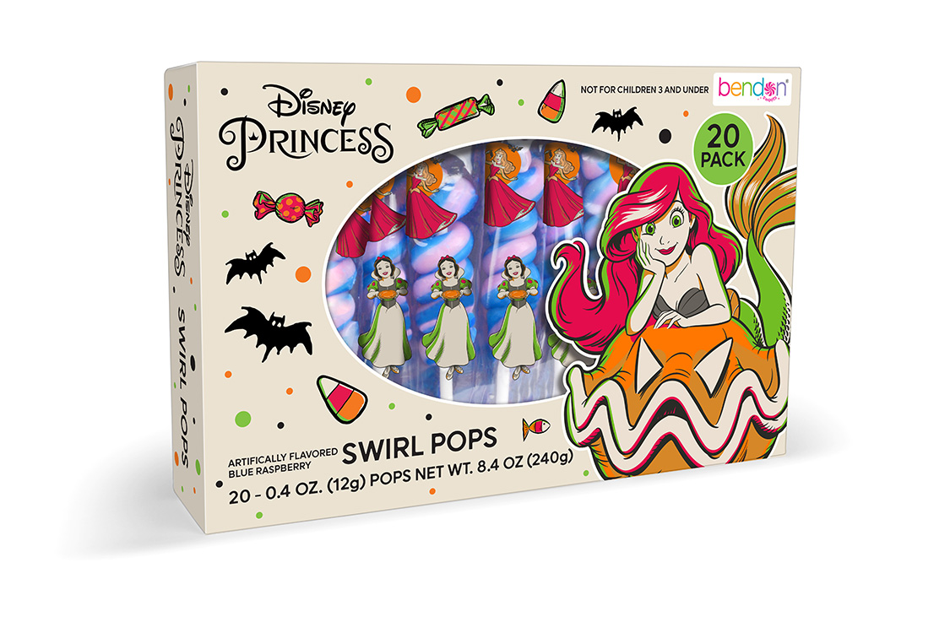
20-pack Swirl Pops
20-pack 0.4oz Swirl Lollipops
Case Pack – 8
SRP: $5.99
Made in a Nut Free facility
HC0004

Slide 9
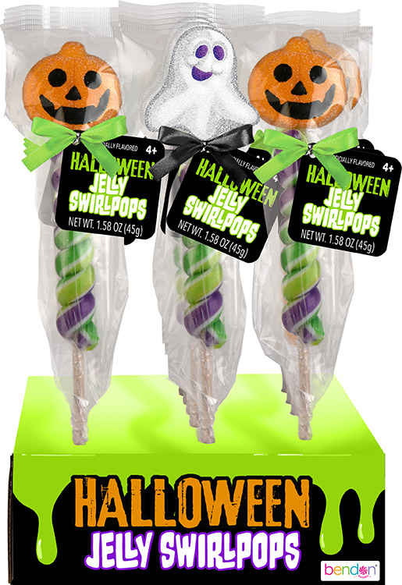
Jelly Character Swirl Pops
1. 85oz Jelly Character Topped Swirl Pops
Case Pack – 12
SRP: $2.99
Made in a Nut Free facility
GT0001

Slide 10
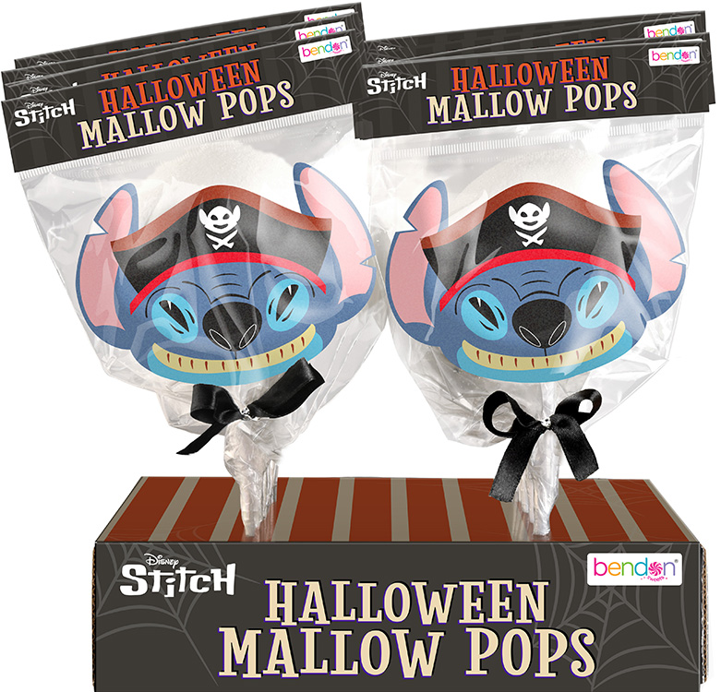
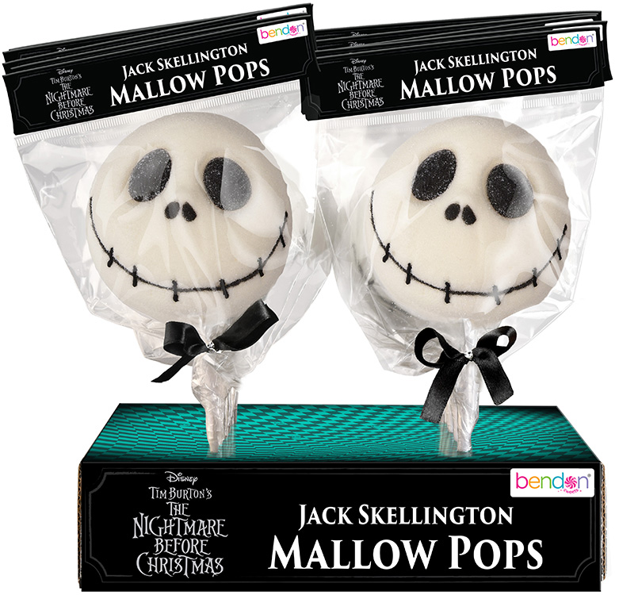
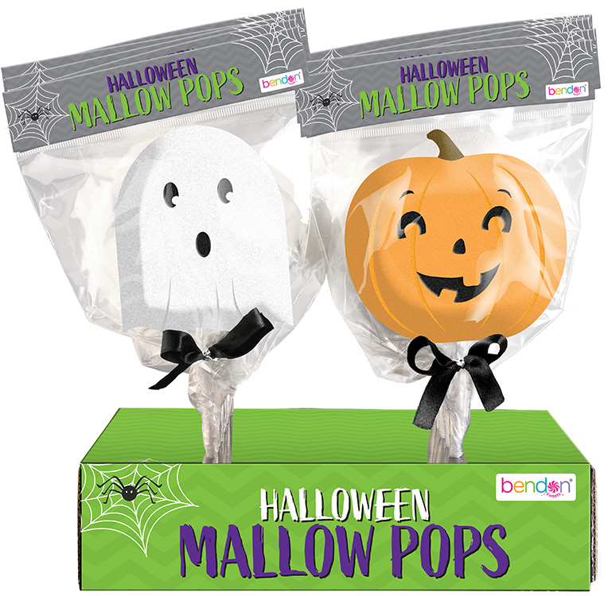
Marshmallow Character Pops
1.05oz Marshmallow Character Shaped Pops
Case Pack – 12
SRP: $2.99
Made in a Nut Free facility
MT0001

Slide 11
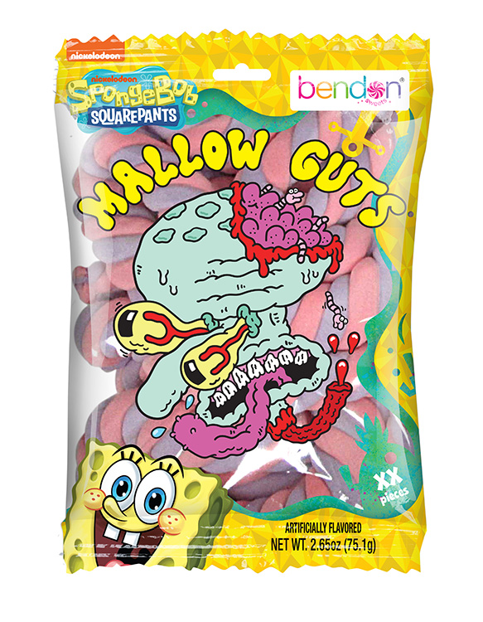
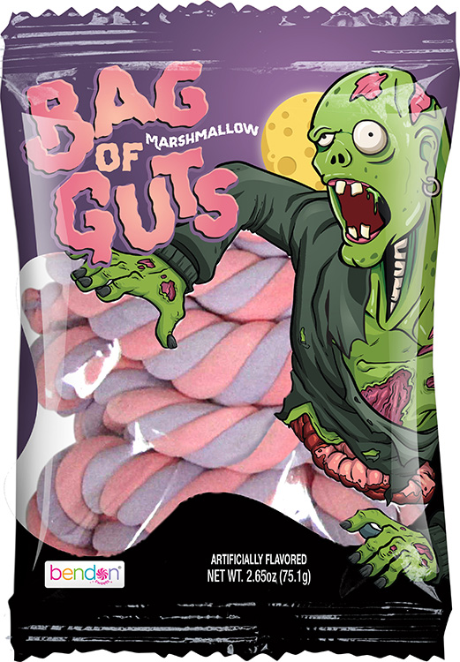
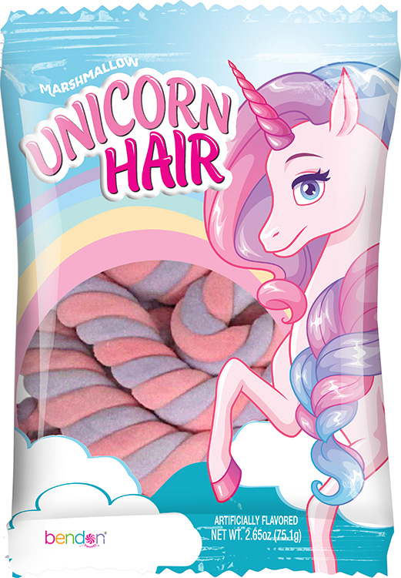
Mallow Guts
2.65oz Mallow Twist
Case Pack – 12
SRP: $2.99
Made in a Nut Free facility
MT0005

Slide 12
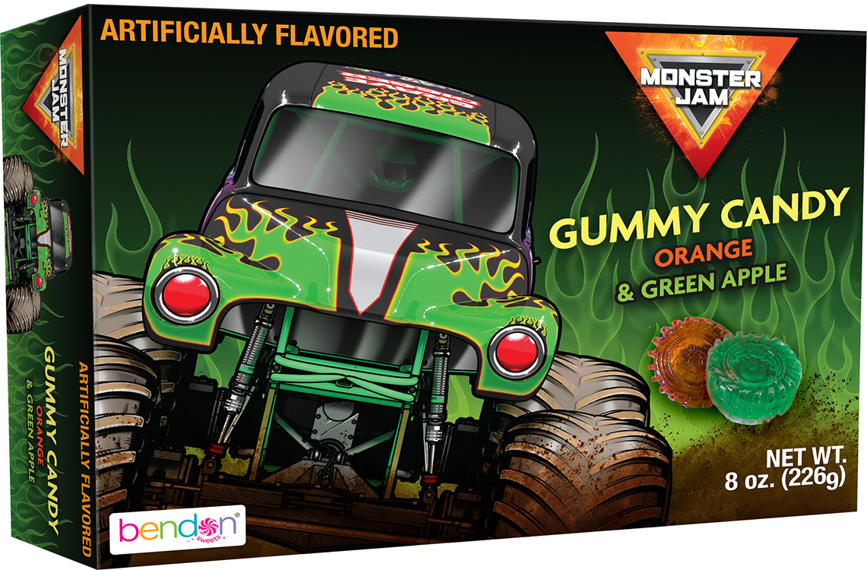
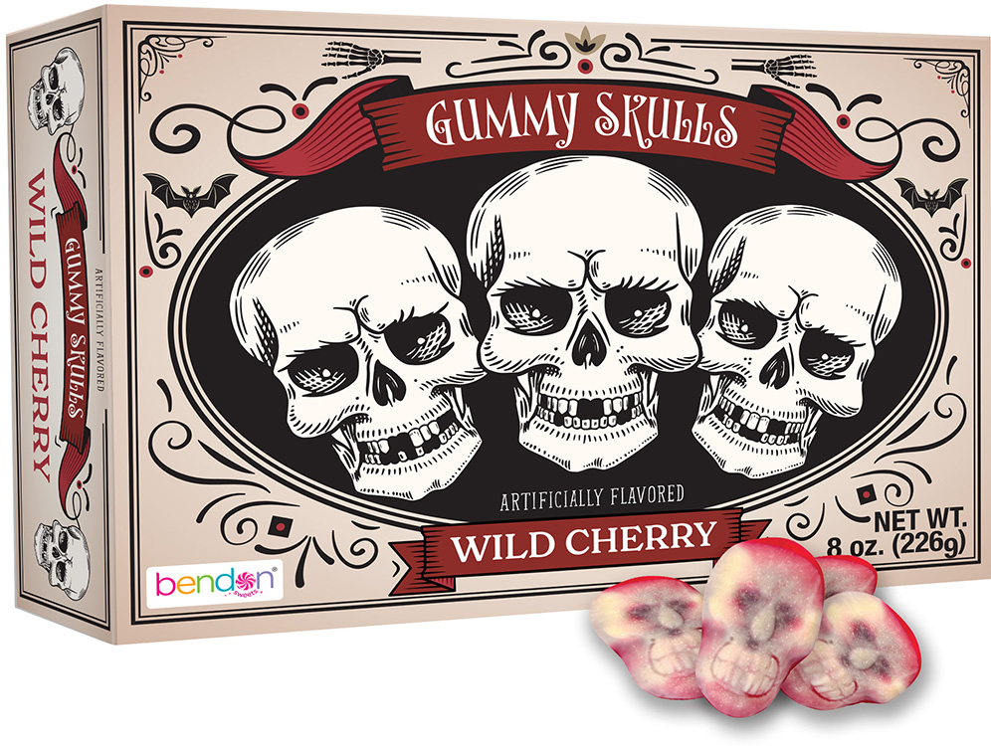
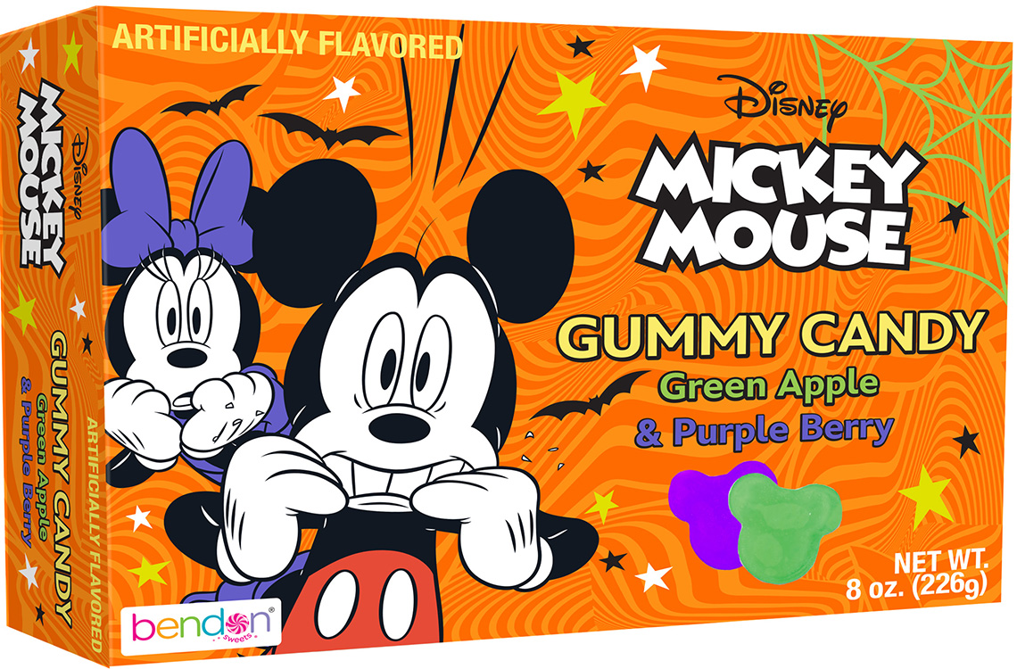
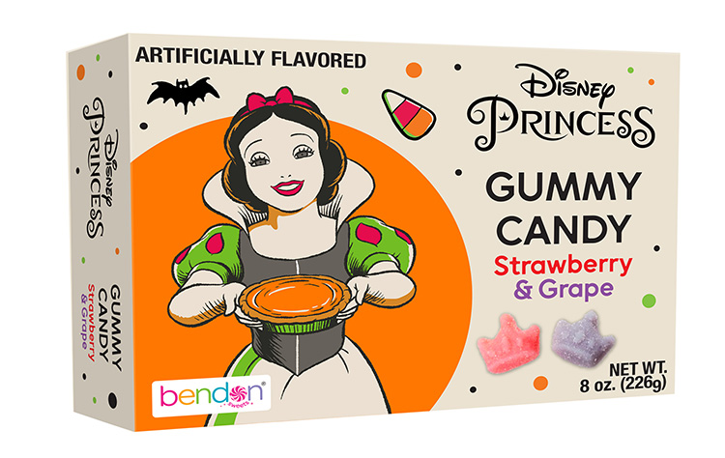
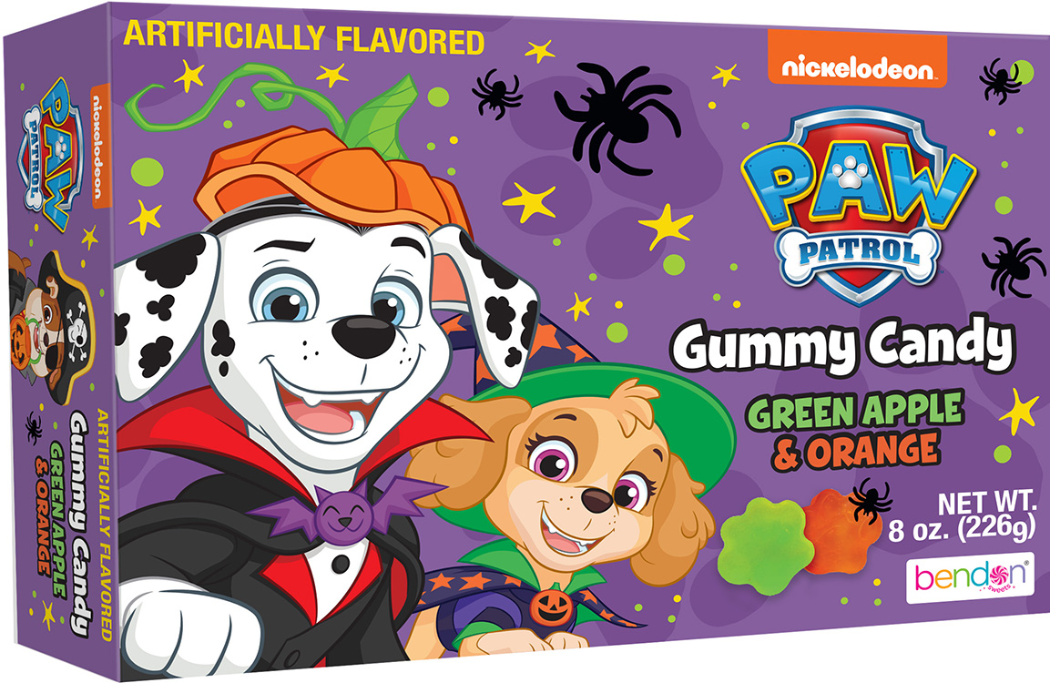
8oz Gummy Boxes
8oz Boxes of Gummies
Case Pack – 6
SRP: $3.99
GT0802

Slide 13
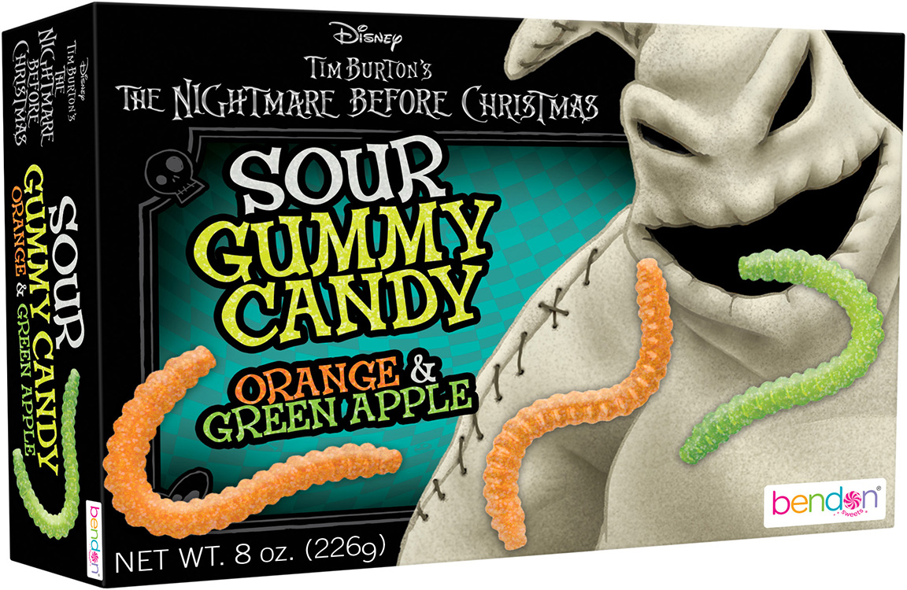
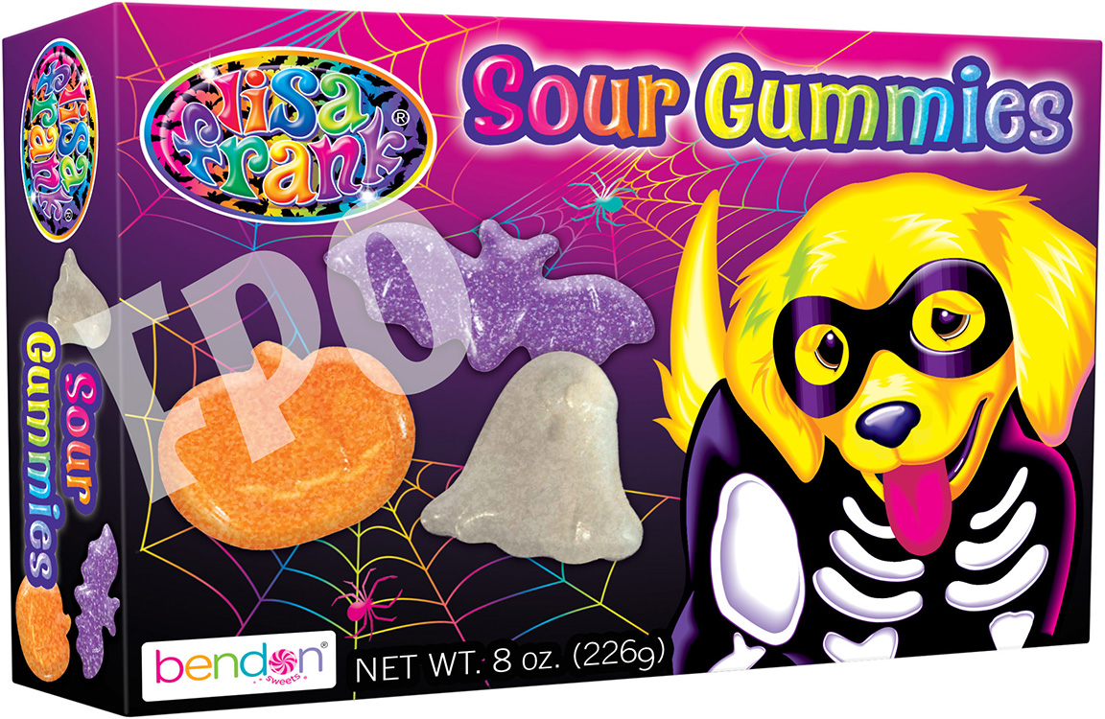
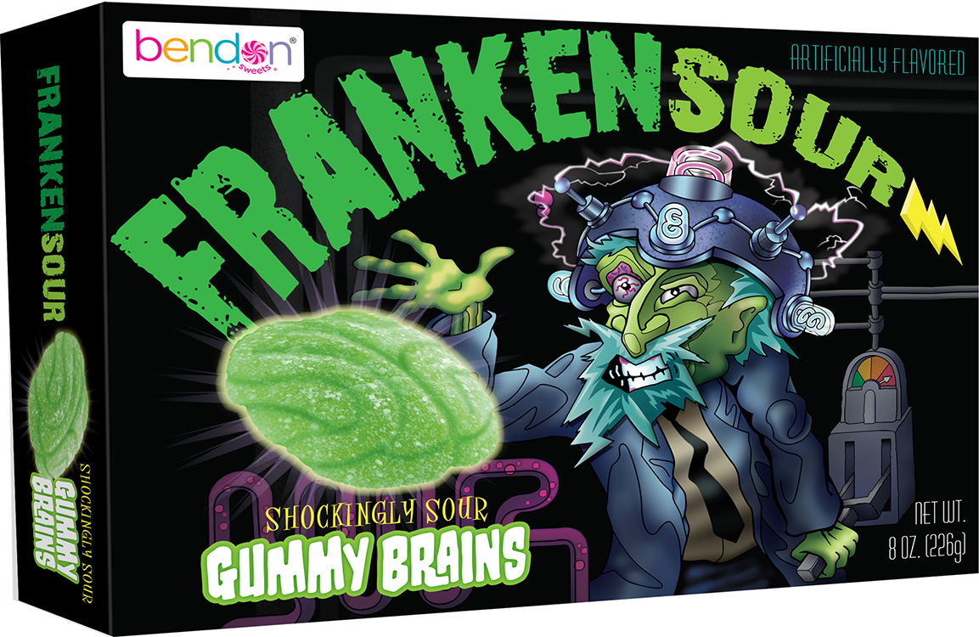
8oz Sour Gummy Boxes
8oz Boxes of Sour Gummies
Case Pack – 6
SRP: $3.99
GT0803

Slide 14
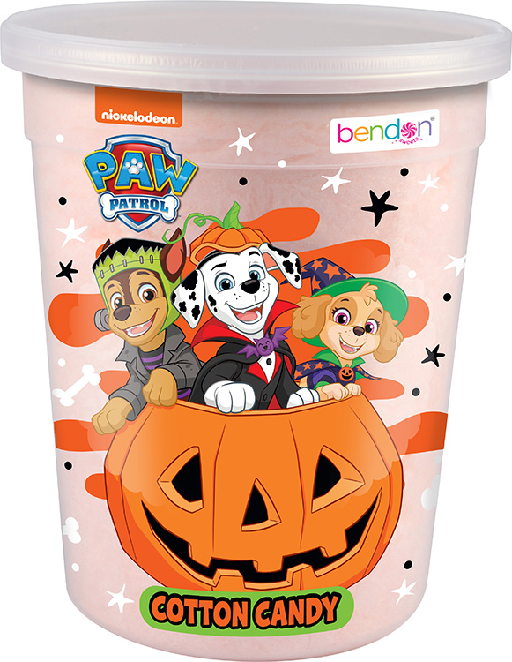
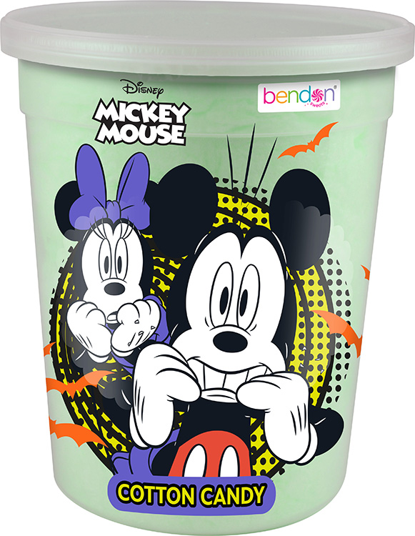
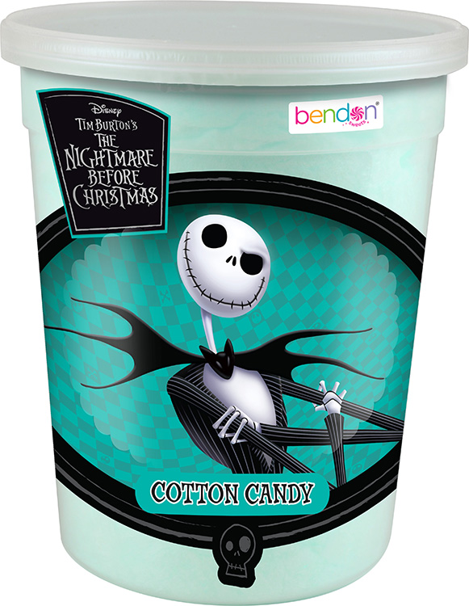
Cotton Candy Tubs
1.5oz Cotton Candy Tub
Case Pack – 12
SRP: $1.99
Made in the U.S.A
Made in a Nut Free facility
CC0001

Slide 15
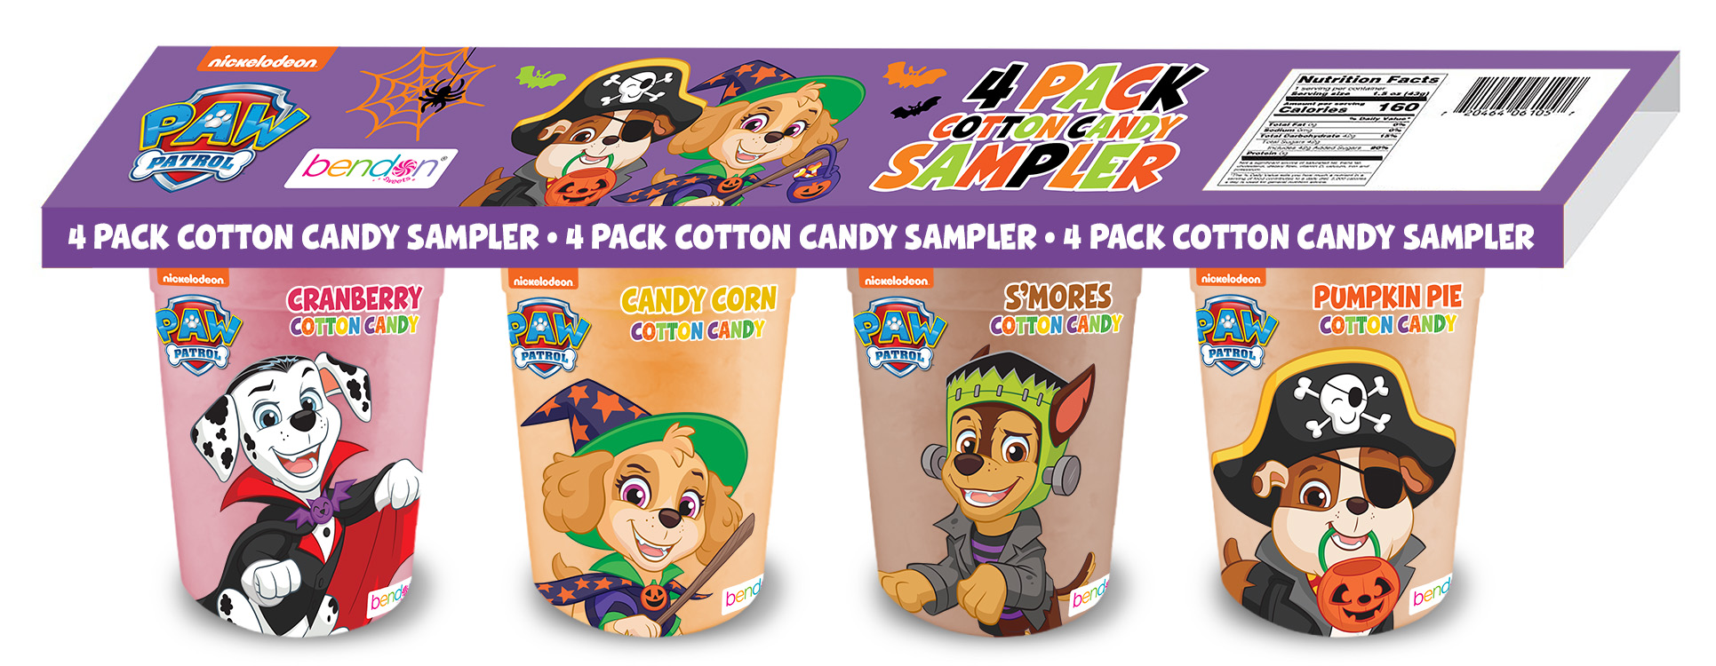
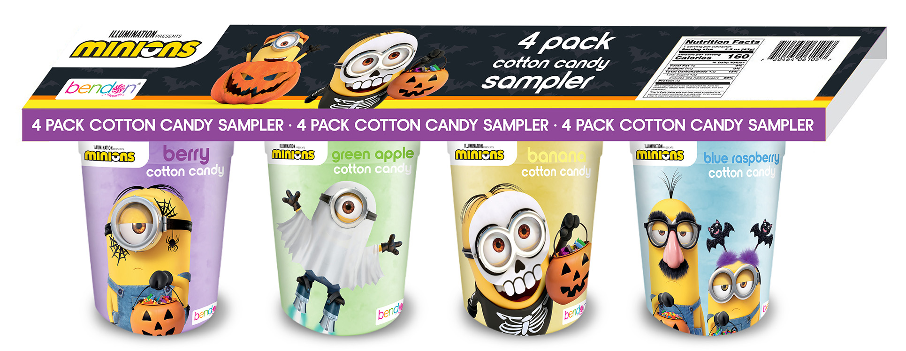

4-pack Cotton Candy
4-pack 6oz (total) Cotton Candy Tubs
Case Pack – 6
SRP: $5.99
Made in the U.S.A
Made in a Nut Free facility
CC0004

Slide 16
Cookies

Slide 17



24-pack 1oz Cookies
24-pack 1oz Cookies
Case Pack – 6
SRP: $12.99
Made in the U.S.A
Made in a nut-free facility
SN-010-1

Slide 18





6oz Cookies
6oz Cookies
Case Pack – 12
SRP: $3.99
Made in the U.S.A
Made in a Nut Free facility
CT0606 – CT0610

Slide 19










Other Bendon Food Options
Delicious, health-conscious snacks
Savory cookies in share-friendly packaging
A sweet reward for your child (or yourself!)

